Slide 1
HTML Lists
HTML Lists are used to specify lists of information. All lists may contain one or more list elements.
There are three different types of HTML lists:
Unordered List or Bulleted List (ul)
Ordered List or Numbered List (ol)
Description List or Definition List (dl)

Slide 2
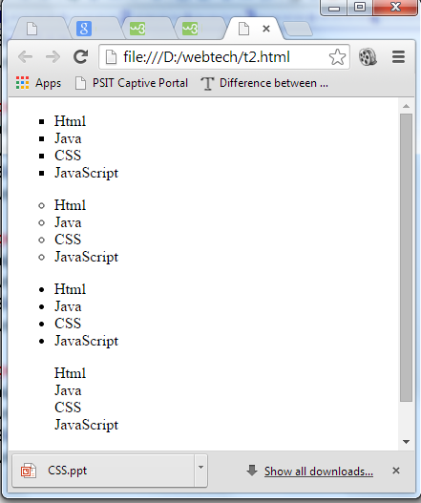
Unordered list:
HTML Unordered List or Bulleted List displays elements in bulleted format. The HTML ul tag is used for the unordered list. There can be 4 types of bulleted list:
square
Circle
disc
none

Slide 3
To represent different ordered lists, there are 4 types of attributes in <ul> tag.
Type | Description
Type "disc" | This is the default style. In this style, the list items are marked with bullets.
Type "circle" | In this style, the list items are marked with circles.
Type "square" | In this style, the list items are marked with squares.
Type "none" | In this style, the list items are not marked .

Slide 4
HTML Unordered List Example:
<ul>
<li>HTML</li>
<li>Java</li>
<li>JavaScript</li>
<li>SQL</li>
</ul>
Output:
HTML
Java
JavaScript
SQL

Slide 5
ul type="circle"
<ul type="circle">
<li>HTML</li>
<li>Java</li>
<li>JavaScript</li>
<li>SQL</li>
</ul>
Output:
HTML
Java
JavaScript
SQL

Slide 6
ul type="square"
<ul type="square">
<li>HTML</li>
<li>Java</li>
<li>JavaScript</li>
<li>SQL</li>
</ul>
Output:
HTML
Java
JavaScript
SQL

Slide 7
ul type="none"
<ul type="none">
<li>HTML</li>
<li>Java</li>
<li>JavaScript</li>
<li>SQL</li>
</ul>
Output:
HTML
Java
JavaScript
SQL

Slide 8
Ordered list:
HTML Ordered List or Numbered List displays elements in numbered format. The HTML ol tag is used for ordered list. There can be different types of numbered list:
Numeric Number (1, 2, 3)
Capital Roman Number (I II III)
Small Romal Number (i ii iii)
Capital Alphabet (A B C)
Small Alphabet (a b c)
To represent different ordered lists, there are 5 types of attributes in <ol> tag.
Fruit
e

Slide 9
To represent different ordered lists, there are 5 types of attributes in <ol> tag.
Type | Description
Type "1" | This is the default type. In this type, the list items are numbered with numbers.
Type "I" | In this type, the list items are numbered with upper case roman numbers.
Type "i" | In this type, the list items are numbered with lower case roman numbers.
Type "A" | In this type, the list items are numbered with upper case letters.
Type "a" | In this type, the list items are numbered with lower case letters.

Slide 10
HTML Ordered List Example
<ol>
<li>HTML</li>
<li>Java</li>
<li>JavaScript</li>
<li>SQL</li>
</ol>
Output:
HTML
Java
JavaScript
SQL

Slide 11
ol type="I"
<ol type="I">
<li>HTML</li>
<li>Java</li>
<li>JavaScript</li>
<li>SQL</li>
</ol>
Output
HTML
Java
JavaScript
SQL

Slide 12
ol type="i"
<ol type="i">
<li>HTML</li>
<li>Java</li>
<li>JavaScript</li>
<li>SQL</li>
</ol>
Output
HTML
Java
JavaScript
SQL

Slide 13
ol type="A"
<ol type="A">
<li>HTML</li>
<li>Java</li>
<li>JavaScript</li>
<li>SQL</li>
</ol>
Output:
HTML
Java
JavaScript
SQL

Slide 14
ol type="a"
<ol type="a">
<li>HTML</li>
<li>Java</li>
<li>JavaScript</li>
<li>SQL</li>
</ol>
Output:
HTML
Java
JavaScript
SQL

Slide 15
start attribute:
The start attribute is used with ol tag to specify from where to start the list items.
<ol type="1" start="5"> : It will show numeric values starting with "5".
<ol type="A" start="5"> : It will show capital alphabets starting with "E".
<ol type="a" start="5"> : It will show lower case alphabets starting with "e".
<ol type="I" start="5"> : It will show Roman upper case value starting with "V".
<ol type="i" start="5"> : It will show Roman lower case value starting with "v".

Slide 16
Example:
<ol type="i" start="5">
<li>HTML</li>
<li>Java</li>
<li>JavaScript</li>
<li>SQL</li>
</ol>
Output:
HTML
Java
JavaScript
SQL

Slide 17
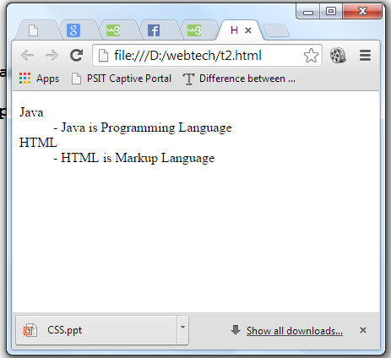
HTML Description List or Definition List
HTML Description list is also a list style which is supported by HTML and XHTML.
It is also known as definition list where entries are listed like a dictionary or encyclopedia.
The definition list is very appropriate when you want to present glossary, list of terms or other name-value list.
The HTML definition list contains following three tags:
<dl> tag defines the start of the list.
<dt> tag defines a term.
<dd> tag defines the term definition (description).

Slide 18
Example
<dl>
<dt>Aries</dt>
<dd>-One of the 12 horoscope sign.</dd>
<dt>Bingo</dt>
<dd>-One of my evening snacks</dd>
<dt>Leo</dt>
<dd>-It is also an one of the 12 horoscope sign.</dd>
<dt>Oracle</dt>
<dd>-It is a multinational technology corporation.</dd>
</dl>

Slide 19
Output:
Aries
-One of the 12 horoscope sign.
Bingo
-One of my evening snacks
Leo
-It is also an one of the 12 horoscope sign.
Oracle
-It is a multinational technology corporation.

Slide 20
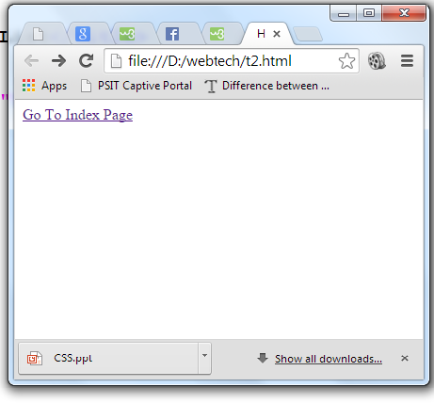
Hyperlinks (Anchor Tag):
Hyperlinks are used for linking:
    within the same page (Named tags)
    To another page in your web site (Relative Link or local link)
    To another page outside your web site (Absolute or remote link)
    Email Link
Hyper Links: are highlighted and underlined text. When you click on it, it takes you to another page on the web.
<A command=“target”>highlighted text</A>

Slide 21
Hyperlinks:
Absolute Link: These are links to another page outside of your web site. These links specify the entire URL of the page:
<A HREF=“http://www.nyu.edu/”>NYU Web Site</A>
NYU Web Site

Slide 22
Hyperlinks:
Relative Link: These are links to another page in your site so you do not have to specify the entire URL.
<A HREF=“index.html”>Go back to main page</A>
Go back to main page

Slide 23
Targeted Links
A tag includes a target attribute. If you specify target=“_blank”, a new browser window will be opened.
<A HREF=“http://www.nyu.edu” target="_blank”> NYU</A>
More on this when we get to frames...

Slide 24
Email Link:
You can someone at:
<a href=“mailto:jj1@nyu.edu”>Send email to J.J.</A>

Slide 25
Lists
<html>
<!–- COMP519 page07.html 23.09.08 -->
<head> <title>(Sort of) Simple Lists</title>
<style type="text/css">
.my_li:before { content: counter(list) ": ";
counter-increment: list; }
</style> </head>
<body>
<ul style="list-style-type: square;">
<li> ... first list item... </li>
<li> ... second list item... ... </li>
</ul>
<dl> <dt> Dweeb </dt>
<dd> young excitable person who may
mature into a <em>Nerd</em> </dd>
<dt> Hacker </dt>
<dd> a clever programmer </dd>
<dt> Nerd </dt> <dd> technically bright but
socially inept person </dd>
</dl>
<ol style="list-style-type: none;
counter-reset: list 29;" >
<li class="my_li">Makes first item number 30.</li>
<li class="my_li">Next item continues to number 31.</li>
</ol>
</body>
</html>
there are 3 different types of list elements
  <ol>…</ol> specifies an ordered list (using numbers or letters to label each list item)
    <li> identifies each list item
    can set type of ordering, start index
  <ul>…</ul> specifies unordered list (using a bullet for each)
    <li> identifies each list item
  <dl>…</dl> specifies a definition list <dt> identifies each term
    <dd> identifies its definition
  * We will learn more about the “style” attributes soon enough.
view page

Slide 26
Hyperlinks
perhaps the most important HTML element is the hyperlink, or ANCHOR
  <a href="URL">…</a>
    where URL is the Web address of the page to be displayed when the user clicks on the link
    if the page is accessed over the Web, must start with http://
    if not there, the browser will assume it is the name of a local file
  <a href="URL" target="_blank">…</a>
    causes the page to be loaded in a new
    Window
  * Find more info on attribute TARGET
<html>
<!–- COMP519 page08.html 15.08.06 -->
<head>
<title>Hyperlinks</title>
</head>
<body>
<p>
<a href="http://www.liv.ac.uk">
The University of Liverpool</a>
<br/>
<a href="page07.html" target="_blank">
Open page07 in a new window</a>
</p>
</body>
</html>
view page

Slide 27
Hyperlinks (cont.)
<html>
<!–- COMP519 page09.html 21.09.12 -->
<head>
<title>Internal Links in a Page</title>
</head>
<body>
<p>
[ <a href="#HTML">HTML</a> |
<a href="#HTTP">HTTP</a> |
<a href="#IP">IP</a> |
<a href="#TCP">TCP</a> ]
</p>
<p>
Computer acronyms:
<dl>
<dt id="HTML">HTML</dt>
<dd>HyperText Markup Language
<dt id="HTTP">HTTP</dt>
<dd>HyperText Transfer Protocol…</dd>
<dt id="IP">IP</dt>
<dd>Internet Protocol…</dd>
<dt id="TCP">TCP</dt>
<dd>Transfer Control Protocol…</dd>
</dl>
</p>
</body>
</html>
for long documents, you can even have links to other locations in that same document
  <xxxx id="ident">…</xxxx>
    where ident is a variable for identifying this location, where "xxxx" can, in principle, be any HTML element
    (this is actually an HTML5 language specification, but seems to work in most browsers)
  <a href="#ident">…</a>
    will then jump to that location within the file
  <a href="URL#ident">…</a>
    can jump into the middle of another file just as easily
view page

